Slide 1

Problem Number 2

Slide 2

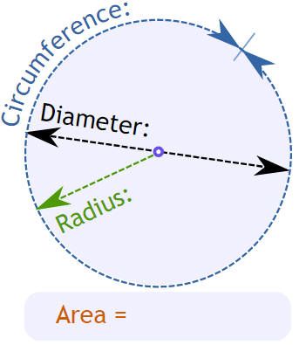
Problem Statement
Write A Python Program To Calculate The Area Of Circle Using Formula Πr²

Slide 3

Algorithm
Step1: Take Radius From User
Step2: Put The Radius In The Formula To Calculate Area Of Circle(Πr2)
Step3: Display The Area Of Circle To User
End

Slide 4

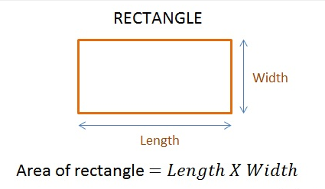
Assignment
Write A Python Program To Calculate The Area Of Rectangle using formula (A*B)

